Slide 1
The design process
Daniel Juarez, Josh Midley, Jackson Darlington

Slide 2
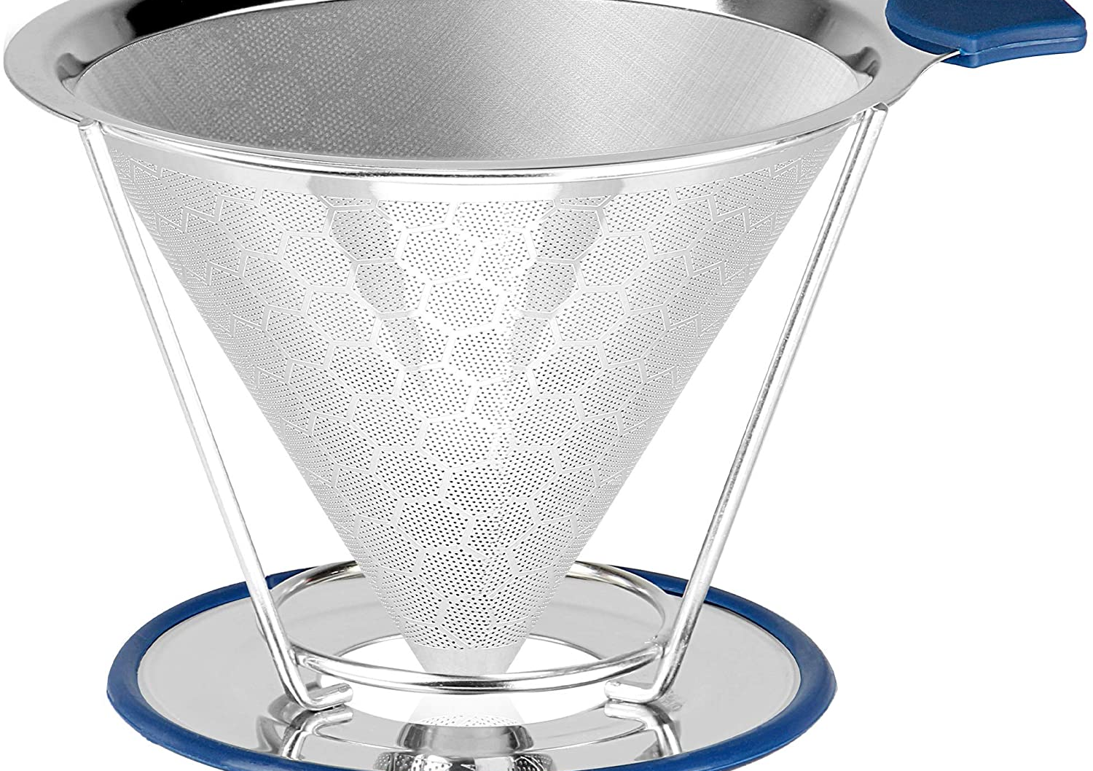
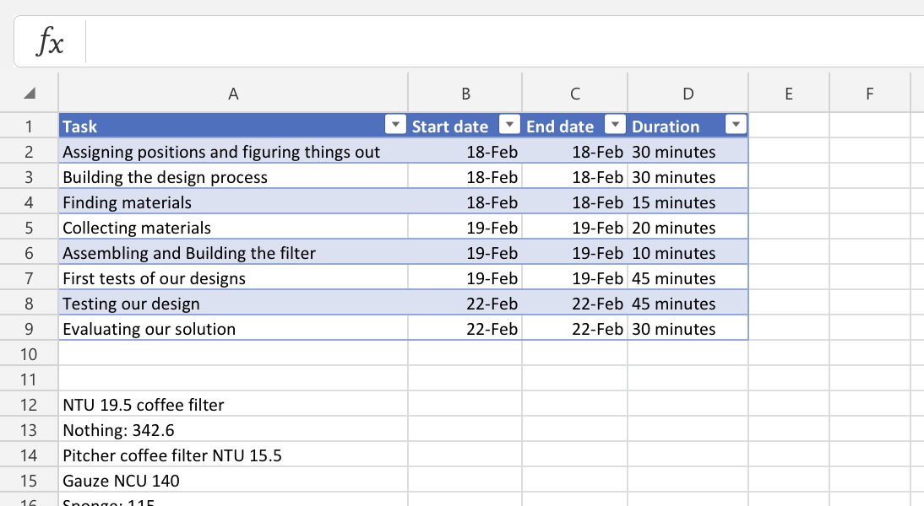
Define the problem

Slide 3
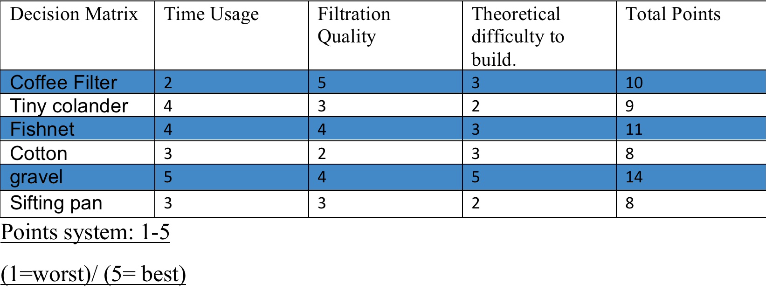
Generate Concepts

Slide 4
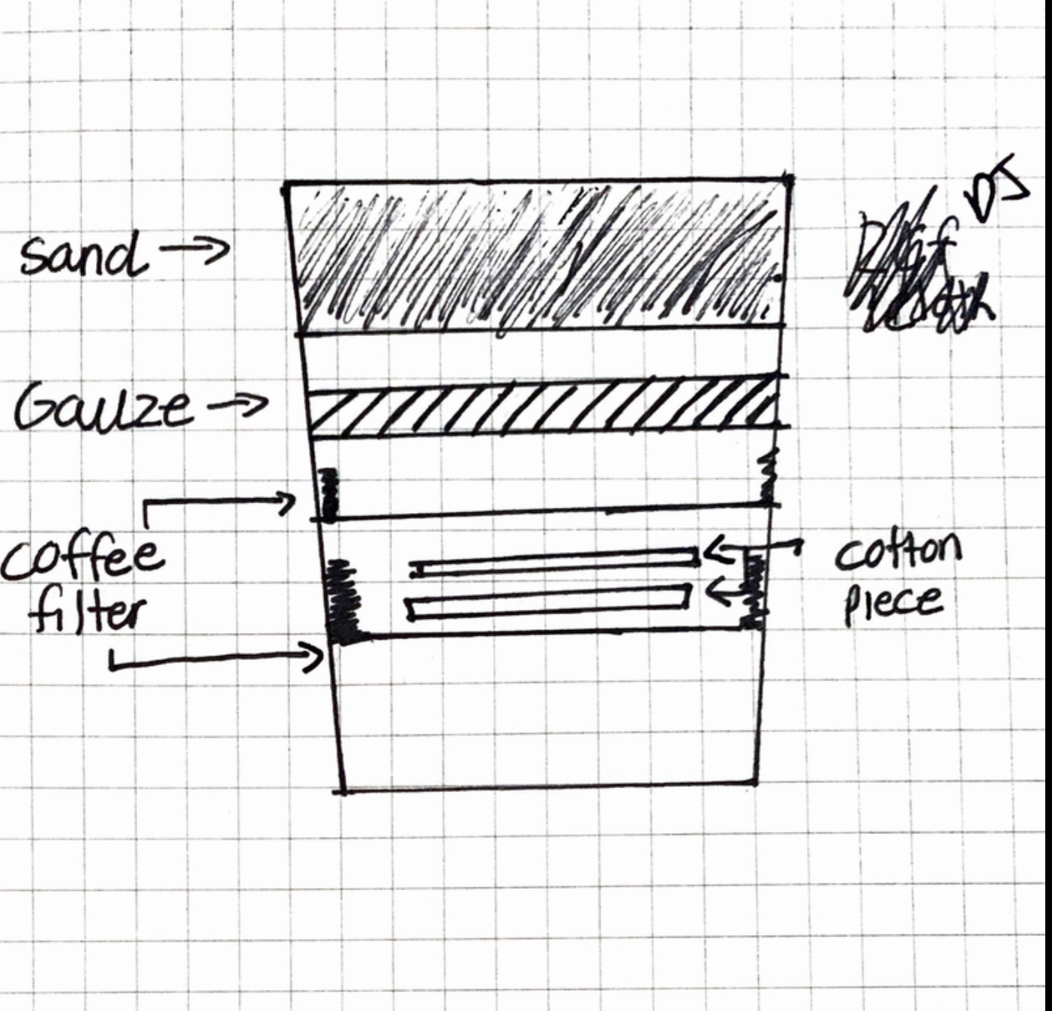
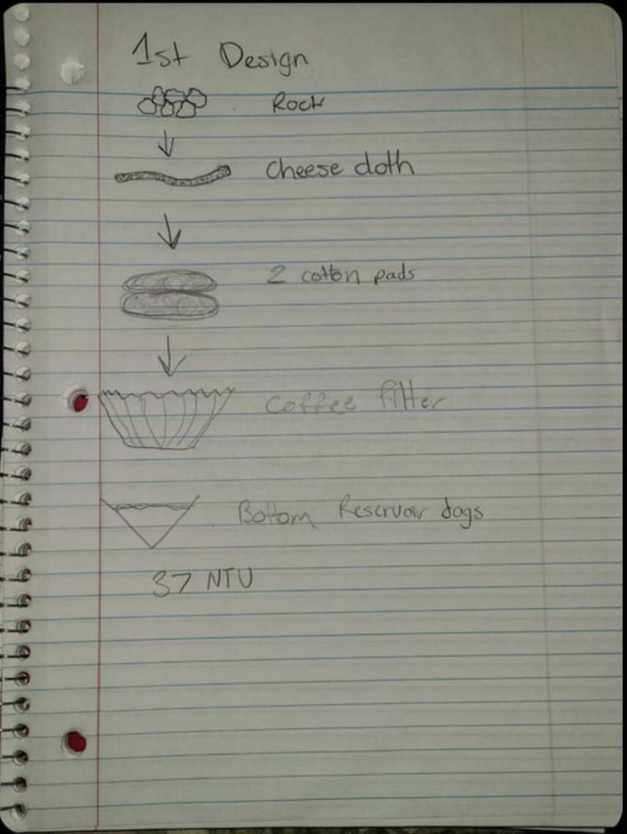
Develop a solution

Slide 5
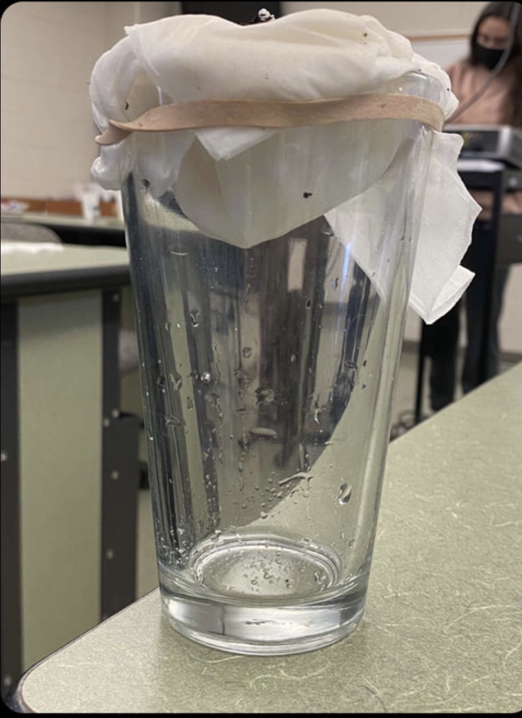
Construct and test the prototype

Slide 6
Evaluate the solution

